Slide 1
Home Automation System
Presented By-
Rajat Gupta(1901640310158)
Himanshu Singh(1901640310105)
Ravi Shankar Gupta(1901640310162)
Ravi Nandan Mishra(1901640310161)
Mentor –
Mrs. Pratibha Singh
(Assistant Professor)

Slide 2

CONTENT
Objective & Scope
Introduction
What is Home Automation ?
Flow Chart
Circuit Diagram
Features of the Project
Hardware Requirement
Advantages
Applications
Conclusion
Reference

Slide 3
OBJECTIVE & SCOPE
The goal of this project is to develop a home automation system that achieves following three main objectives.
Safety
Security
Comfort

Slide 4
INTRODUCTION
Home automation is building automation for a home, called a smart home or smart house.
A home automation system will monitor and/or control home attributes such as lighting, climate, entertainment systems, and appliances.
It may also include home security such as access control and alarm systems.
When connected with the internet, home devices are an important constituent of the internet of things ("IoT").
A home automation system typically connects controlled devices to a central smart home hub (sometimes called a "gateway").

Slide 5
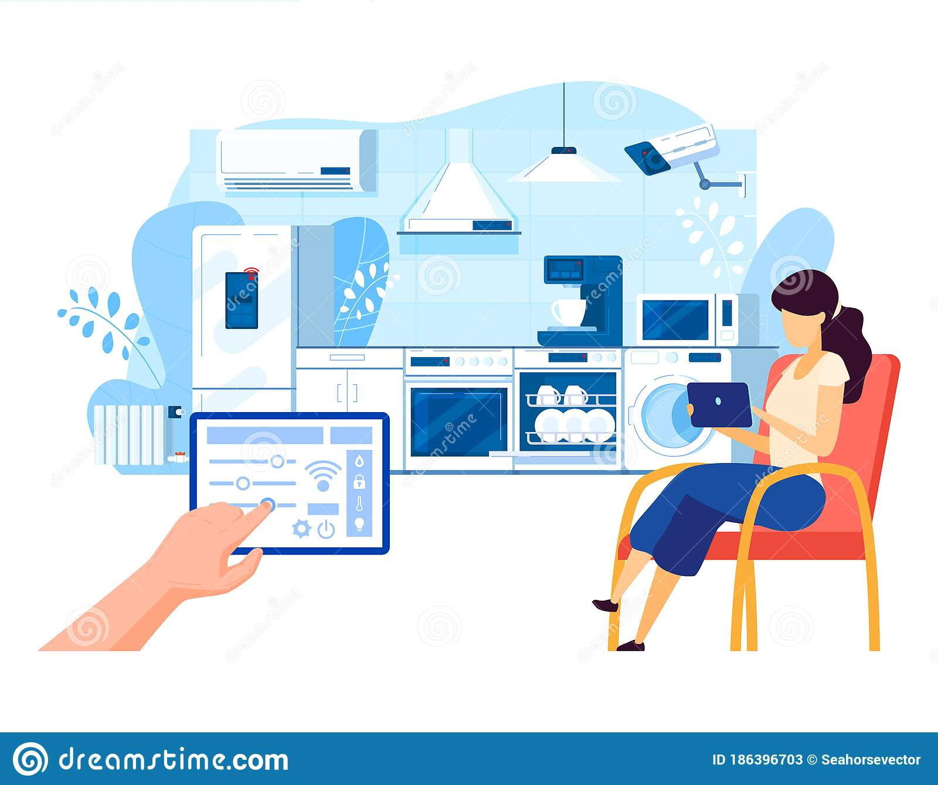
What is Home automation ?

Slide 6
What is Home Automation ?
Home automation refers to the use of technology to control and automate various aspects of a home, such as lighting, heating, air conditioning, security, and entertainment systems.
Home automation systems typically involve the use of sensors, controllers, and smart devices that can be programmed to perform specific tasks or respond to certain conditions.
The benefits of home automation include increased convenience, improved energy efficiency, enhanced security, and greater control over various aspects of the home environment.

Slide 7
FLOW CHART
Web app connected
START
Module Connected to Network
Application command
END
Relay Switch react on that Command
Module gives command to Relay Switch

Slide 8
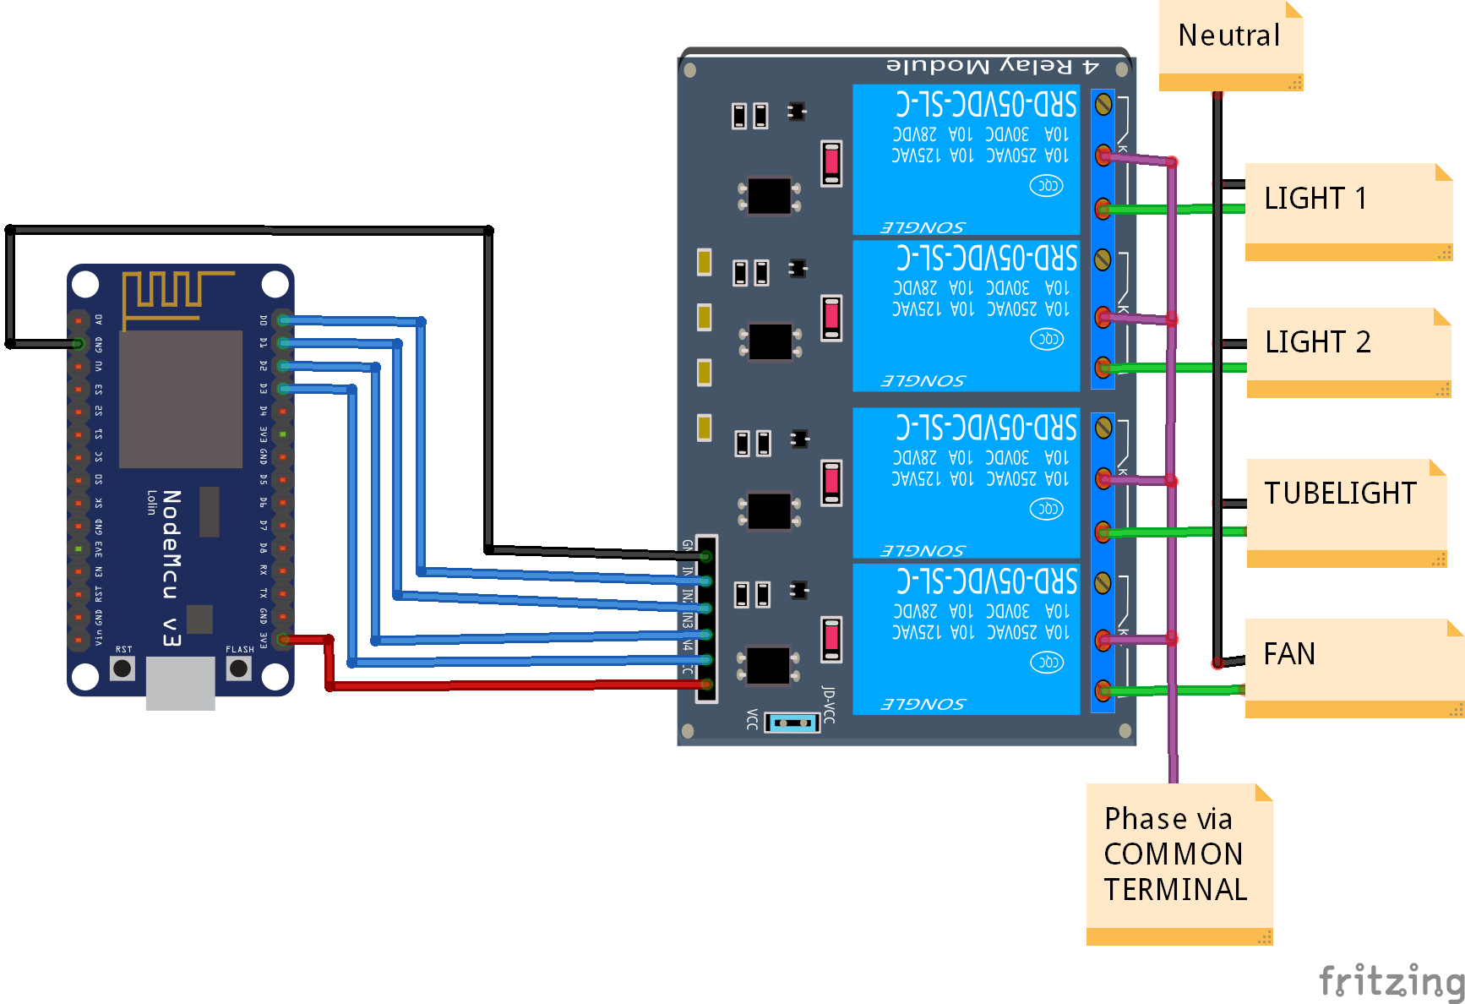
CIRCUIT DIAGRAM
ESP 32 CAM

Slide 9

FEATURES OF THE PROJECT
1. Remote Control
Smart home automation system offers you the opportunity to control your devices through a remote controlling system. You can manage the devices from thousands of miles with the aid of a smartphone and the internet.

Slide 10

2. Intelligent security
Home automation solutions can help in managing the security of your home. You can collect data through gadgets like cameras and sensors, and analyze those data will help you enhance your home's security.

Slide 11
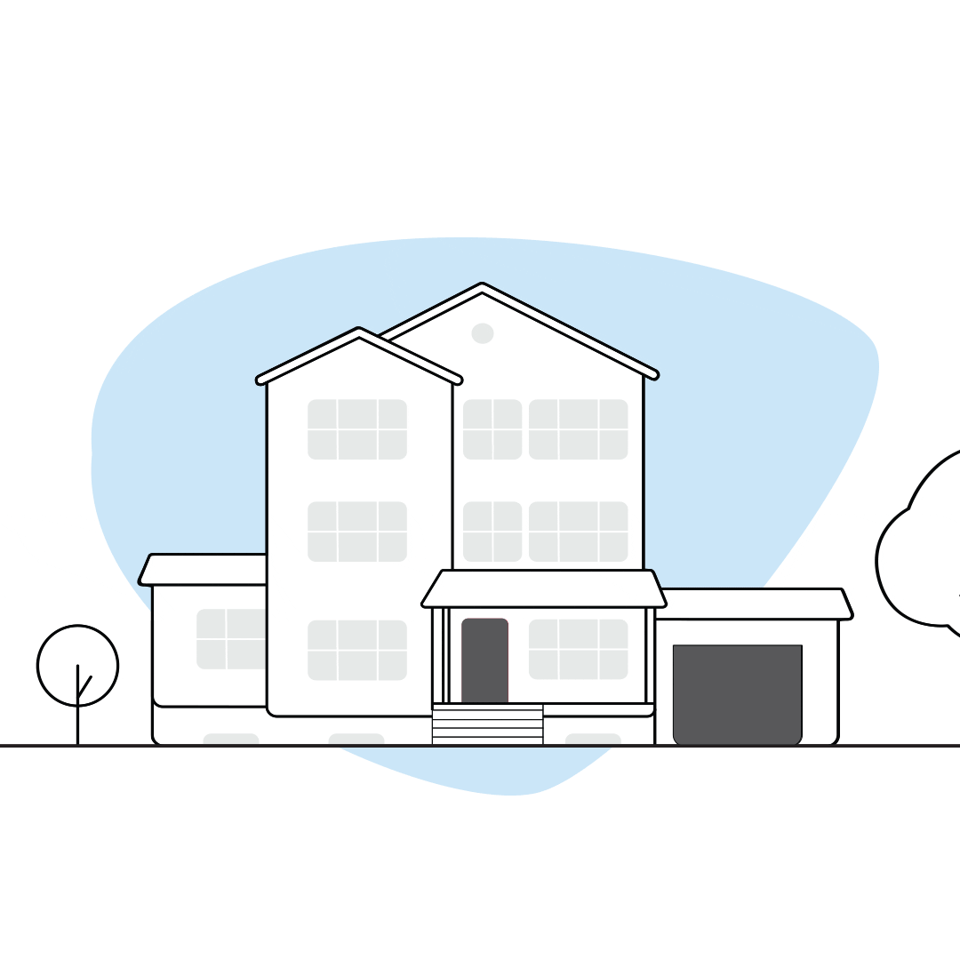
3. Smart Doors
With the ability to lock and unlock remotely, homeowners can easily grant access to guests or delivery personnel without physically being there.
In addition, the door can be integrated with other smart devices in the home, such as security cameras or smart thermostats, to create a comprehensive and interconnected system.

Slide 12

4. Fire Safety
Automatic fire alarm system provides real-time surveillance, monitoring and automatic control on fire. A key aspect of fire protection is to identify a developing fire emergency in a timely manner, and to alert the building's occupants and fire emergency organizations.

Slide 13

5. Intelligent lighting
Lights in your home can be managed using a smart home automation system. You can change the brightness and intensity of the light to suit your needs

Slide 14

6. Energy Efficiency
Home automation allows you to be more mindful of your power usage. For example, you can save on energy bills by reducing the length of time that lights stay on, or by lowering temperatures when you leave a room.

Slide 15
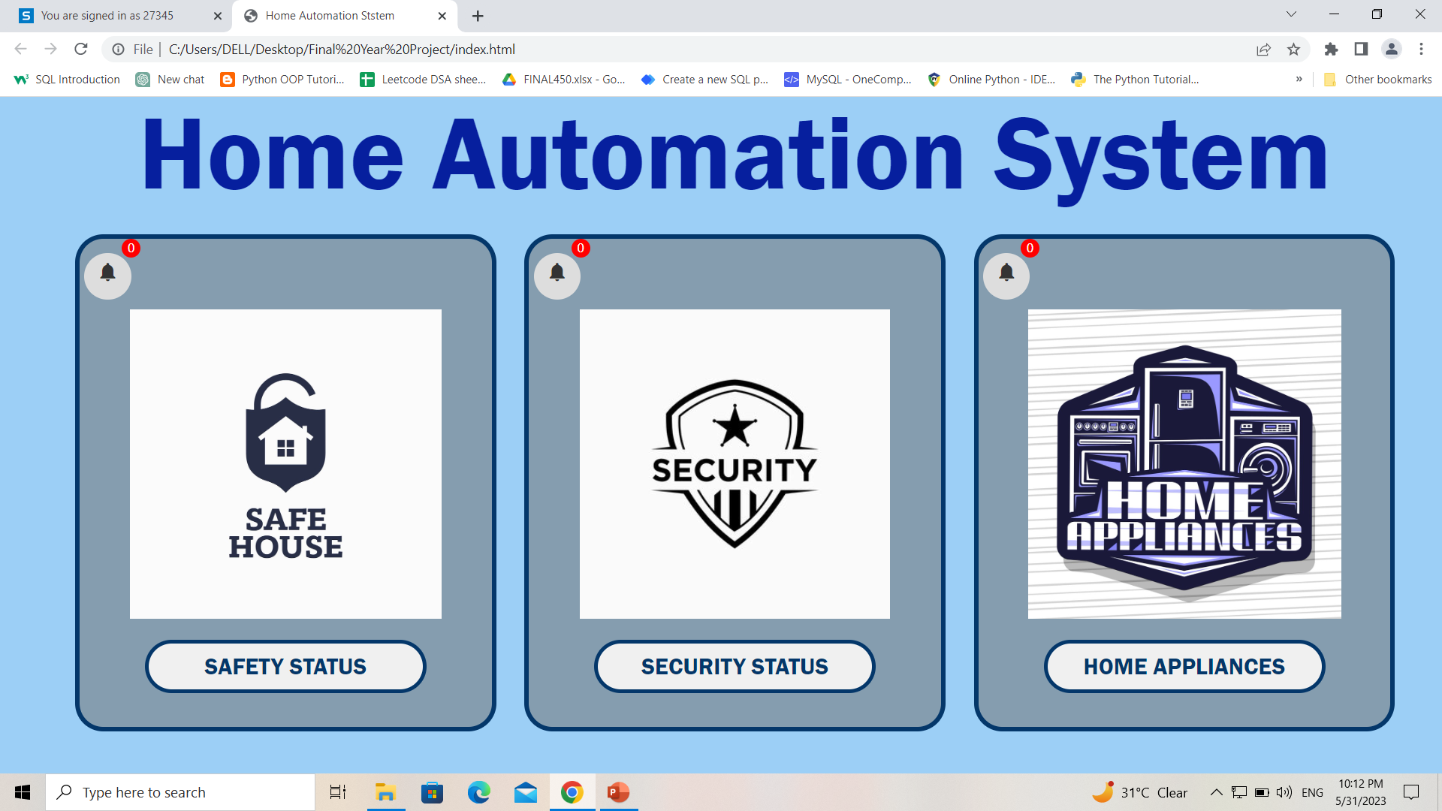
SOFTWARE

Slide 16
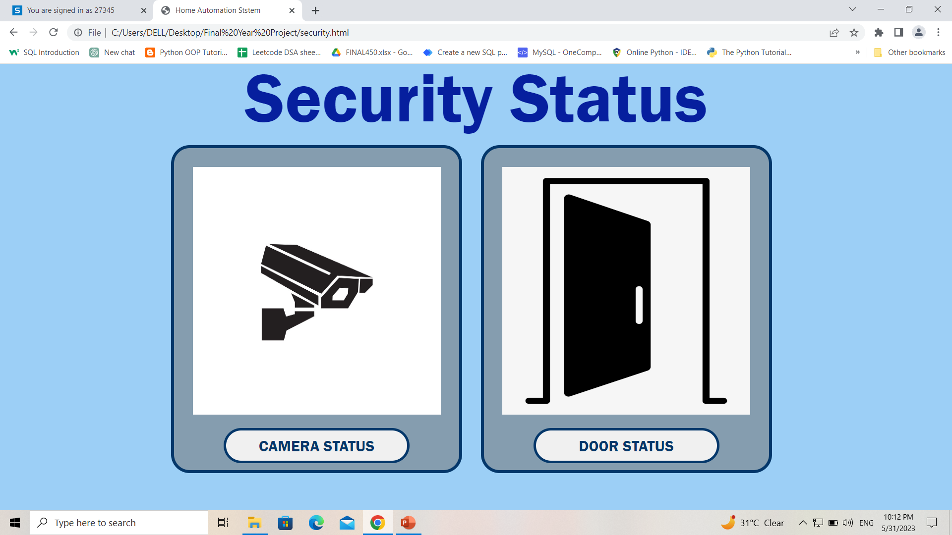
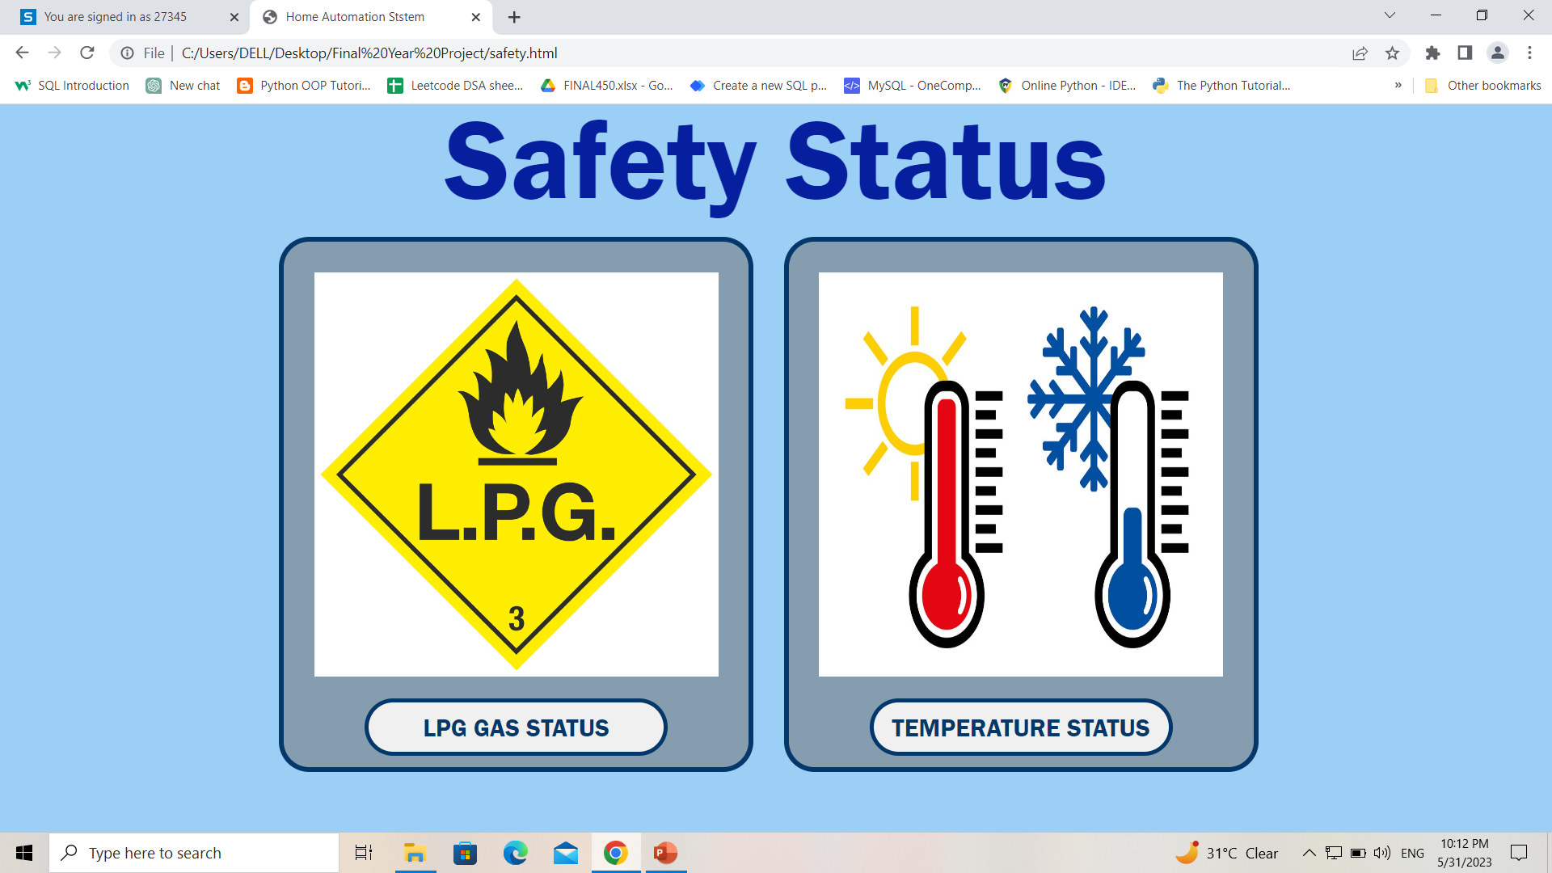
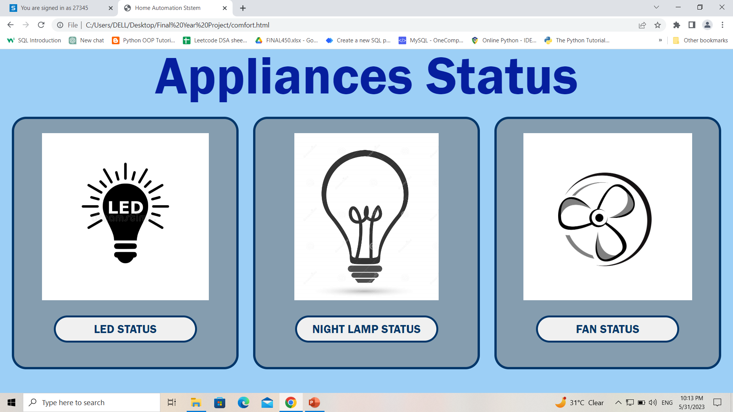

Slide 17
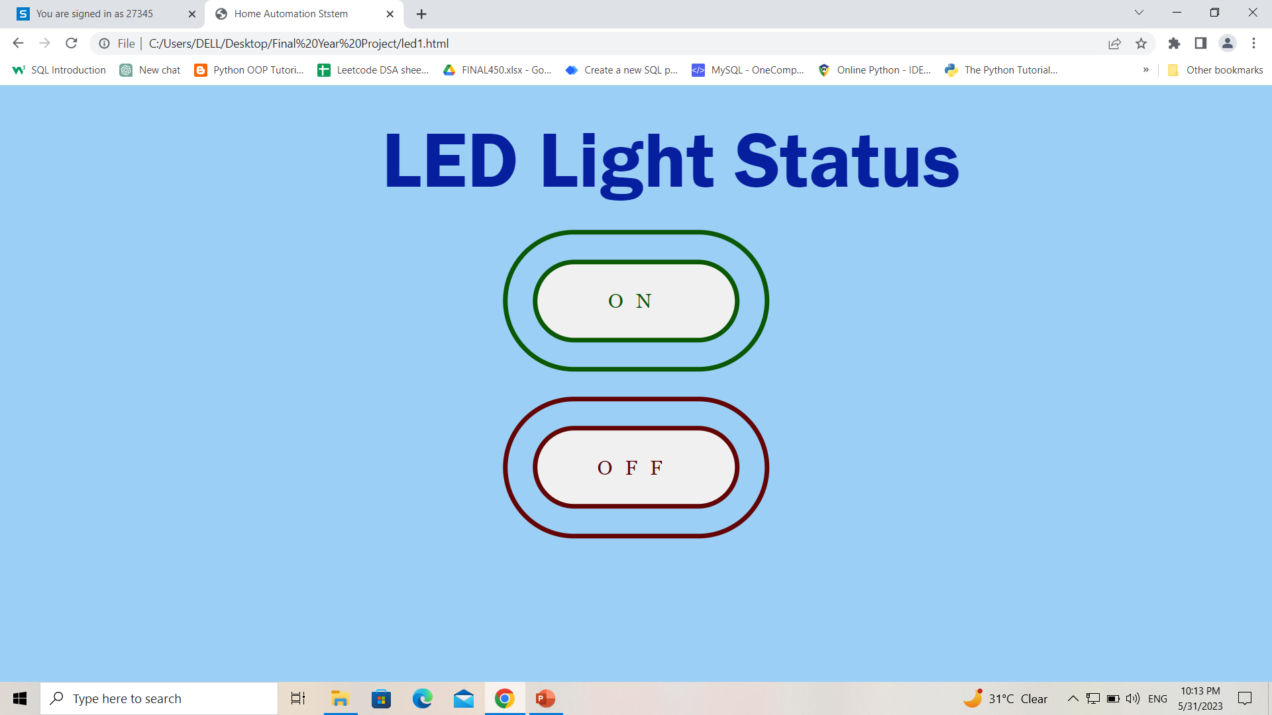
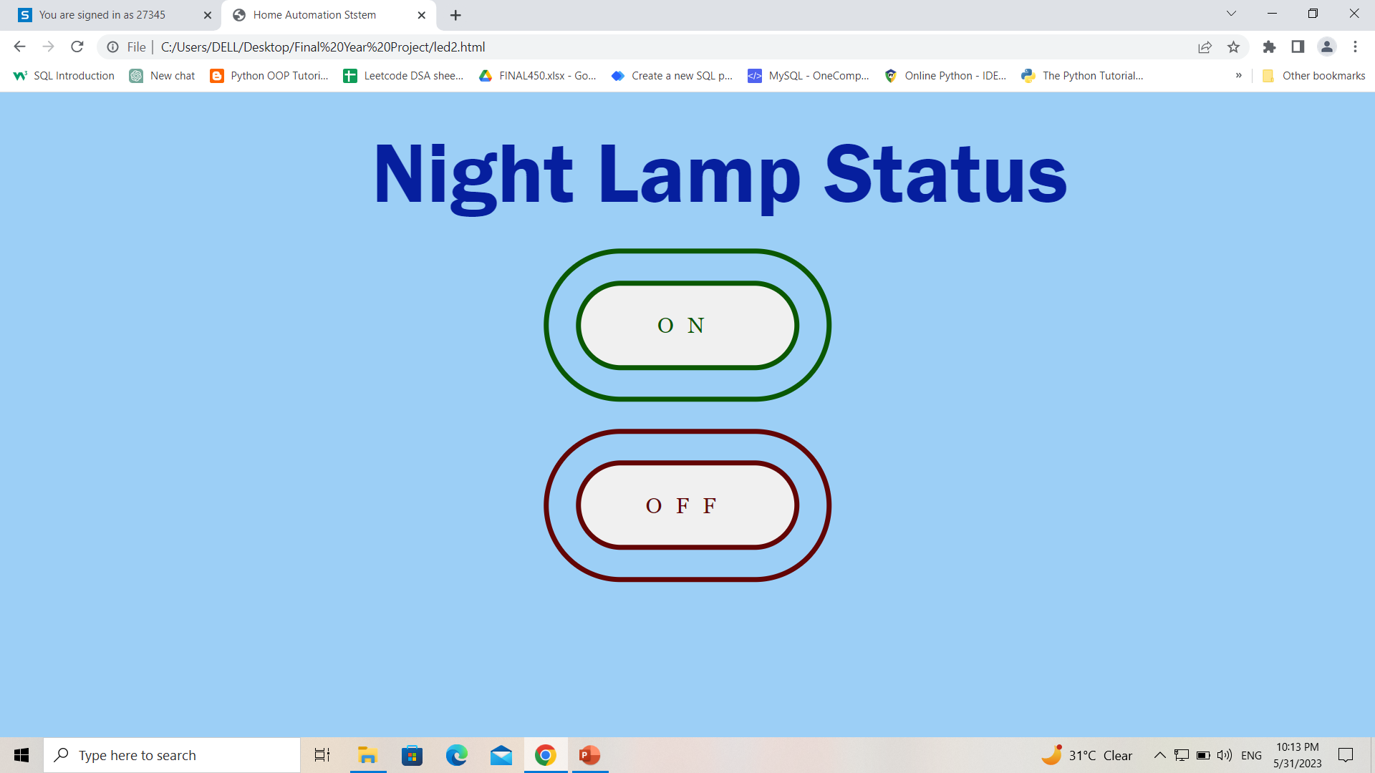
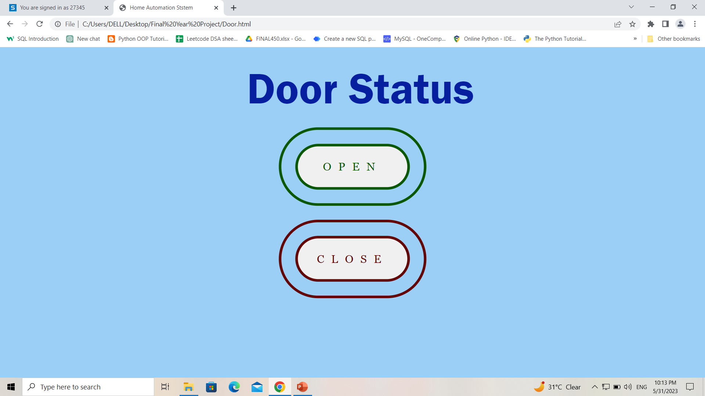
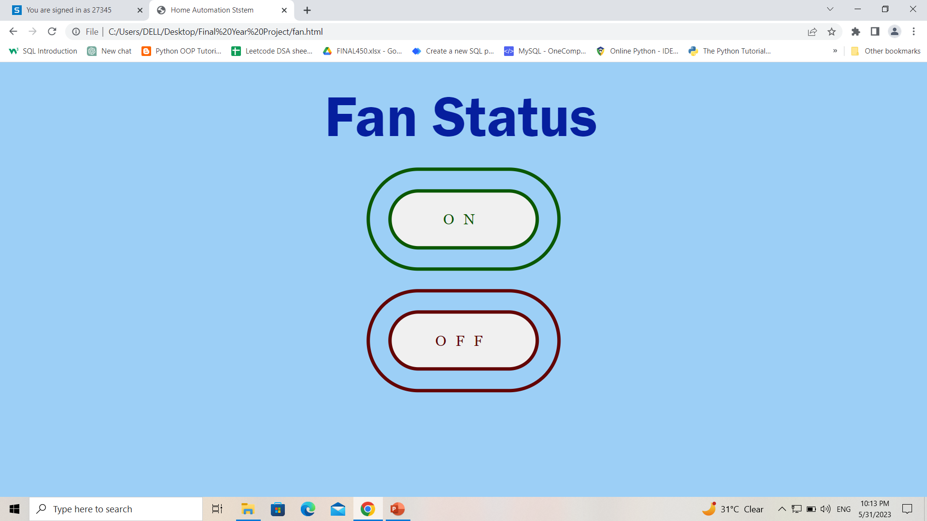

Slide 18
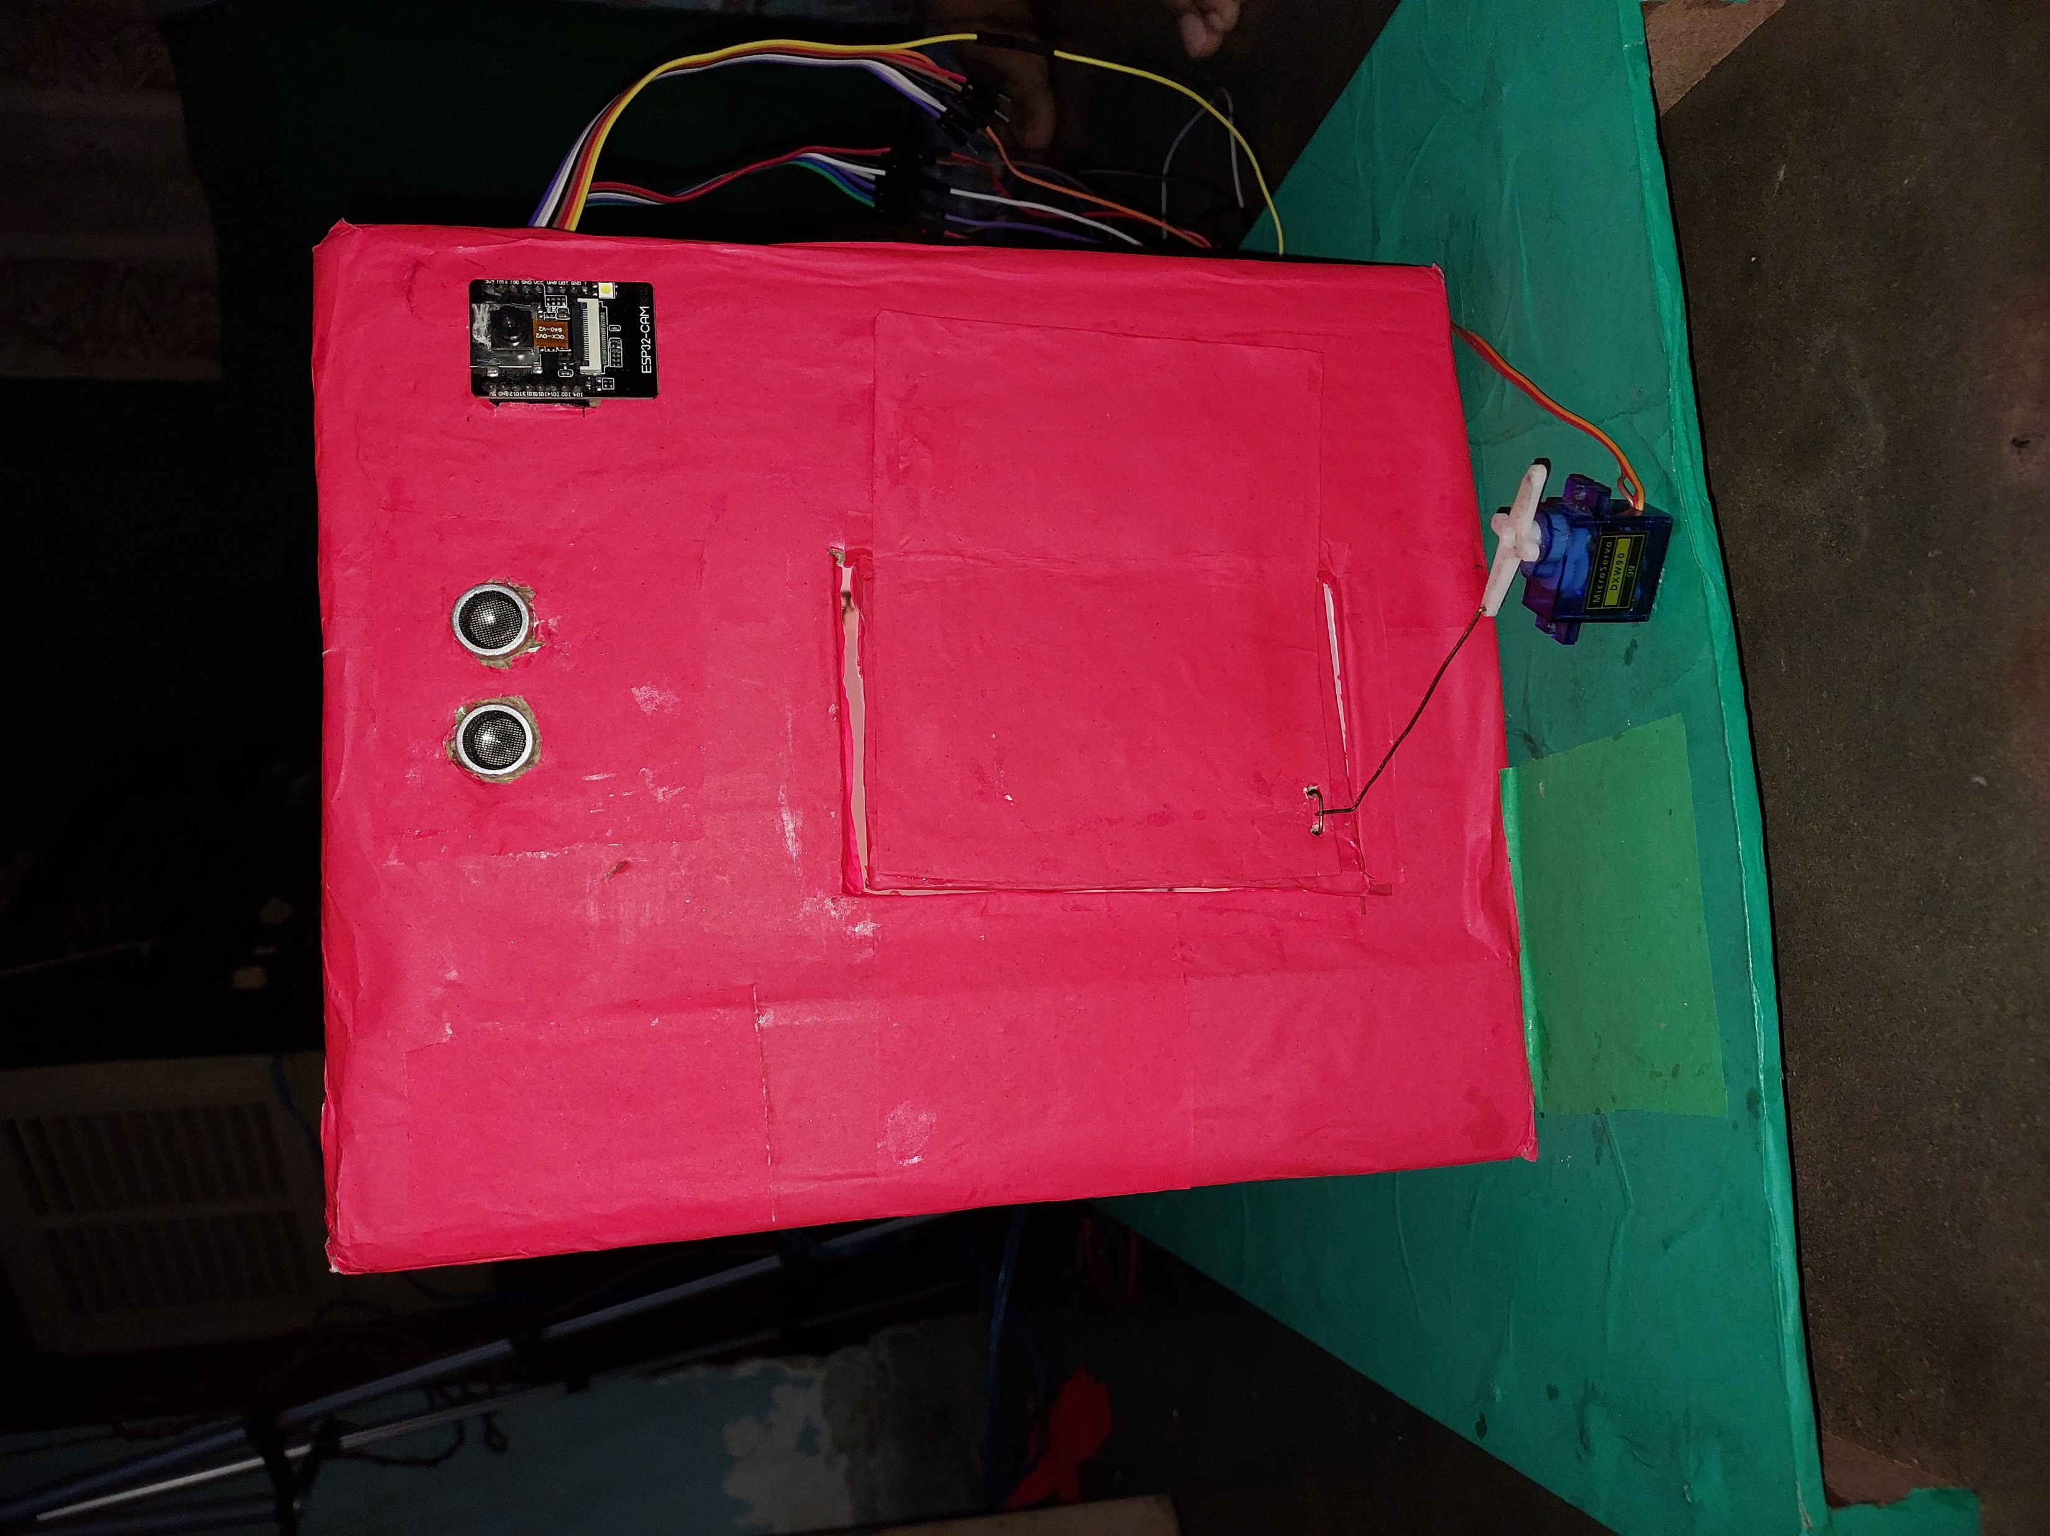
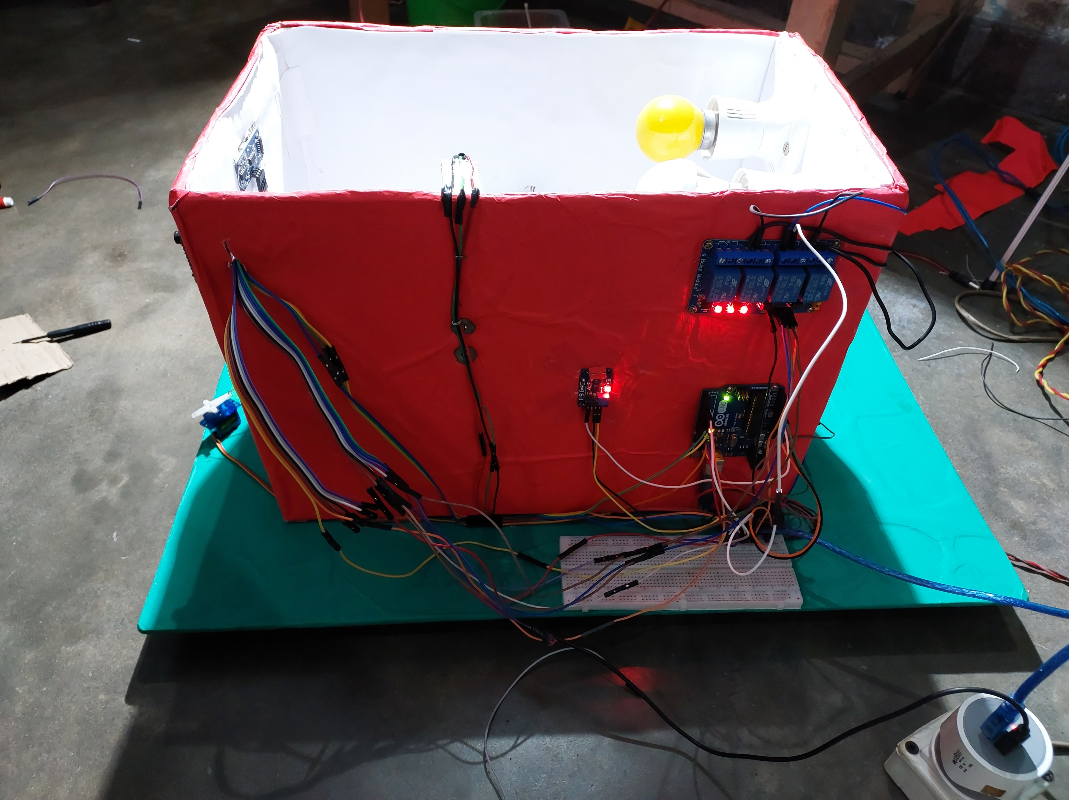
HARDWARE
FRONT VIEW
SIDE VIEW

Slide 19
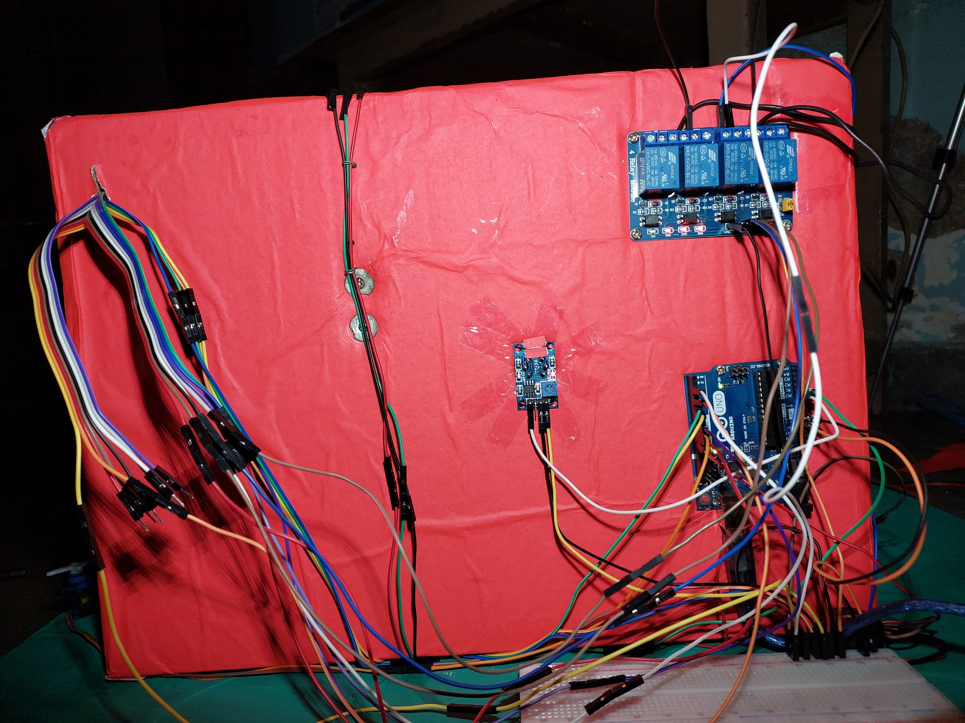
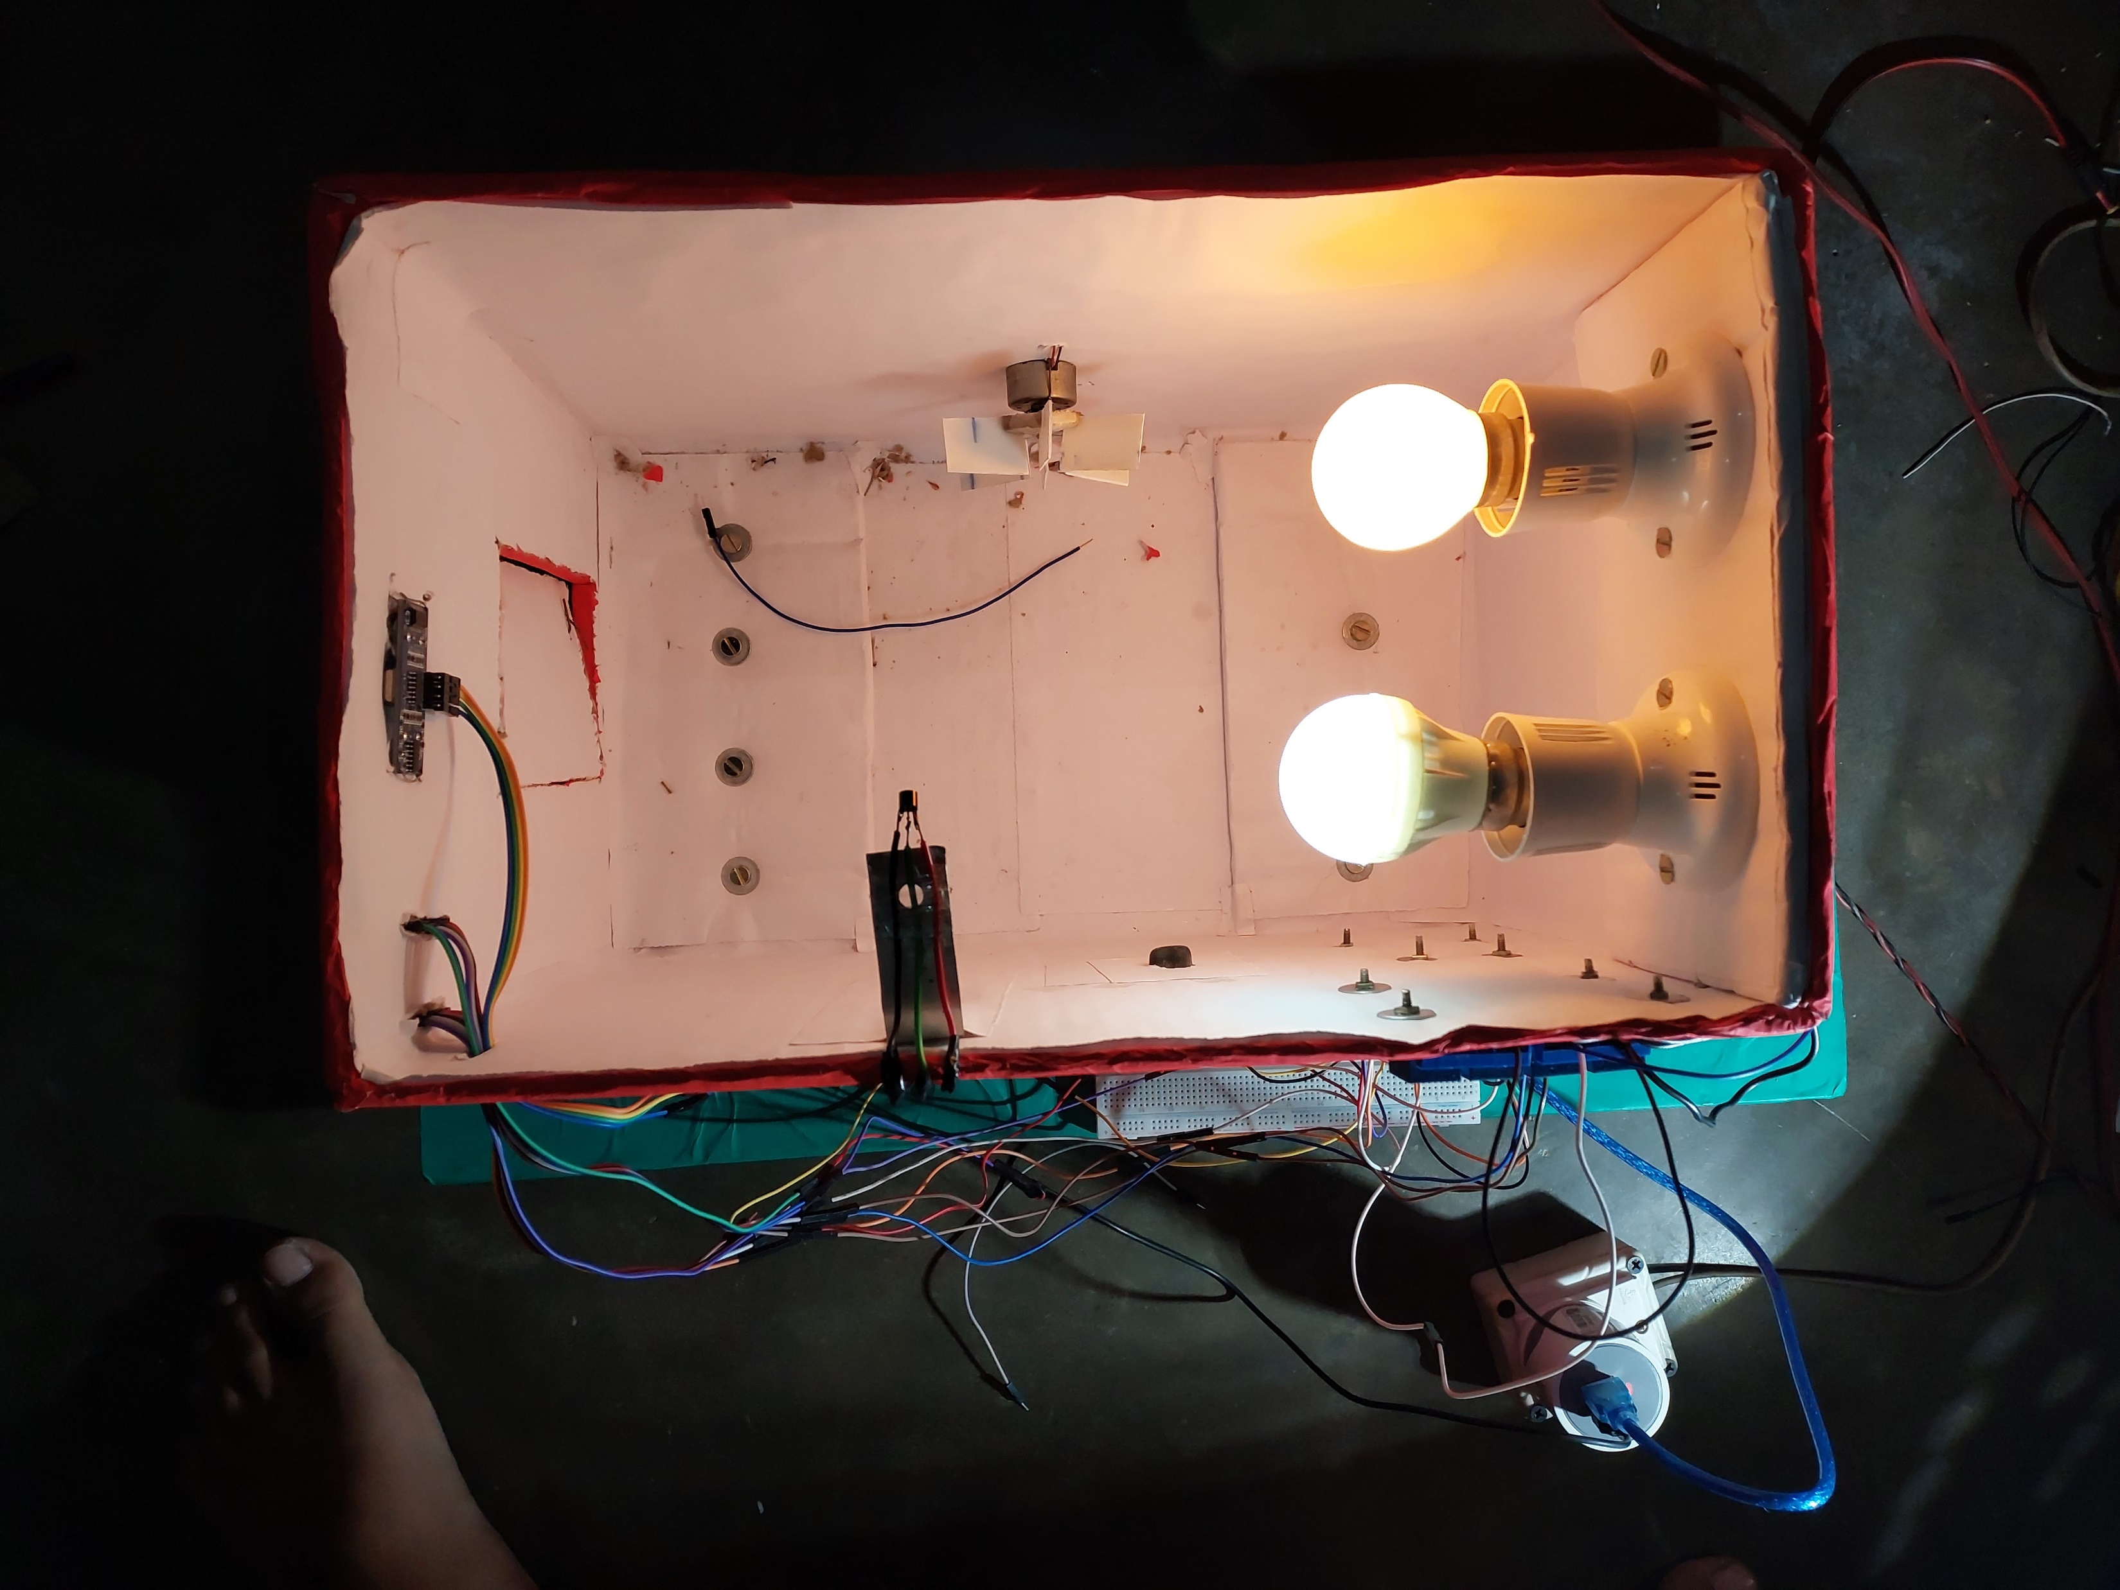
REAR VIEW
TOP VIEW

Slide 20
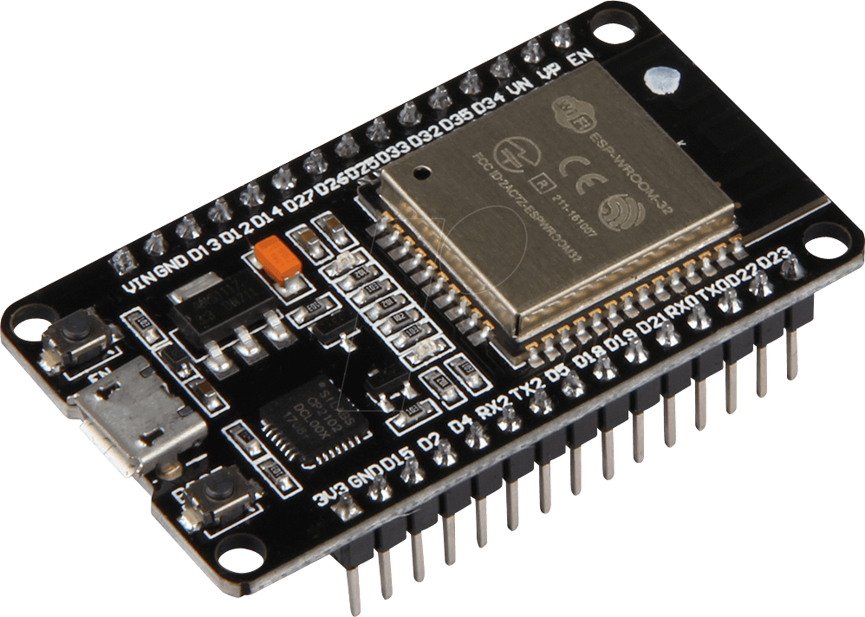
HARDWARE REQUIREMENTS
1.ESP32 Development board
ESP32 is a series of low-cost, low-power system on a chip microcontrollers with integrated Wi-Fi and dual-mode Bluetooth.
Main processor: Tensilica Xtensa 32-bit LX6 microprocessor
Cores: All versions of the ESP32 series are dual-core except for ESP32-S0WD, which is single-core.
Clock frequency: up to 240 MHz Performance: up to 600 DMIPS

Slide 21
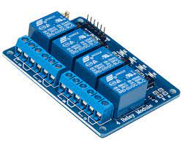
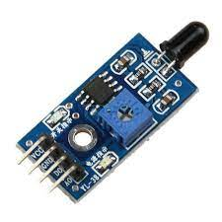
2. Relay
The Four channel Relay Module is a convenient board which can be used to control high voltage, high current load such as motor, solenoid valves, lamps and AC load.
It is designed to interface with microcontroller such as Arduino, PIC and etc.
3. Heat Detector
A heat detector is a fire alarm device designed to respond when the convicted thermal energy of a fire increases the temperature of a heat sensitive element.
Heat detectors have two main classifications of operation, "rate-of-rise" and "fixed temperature".

Slide 22
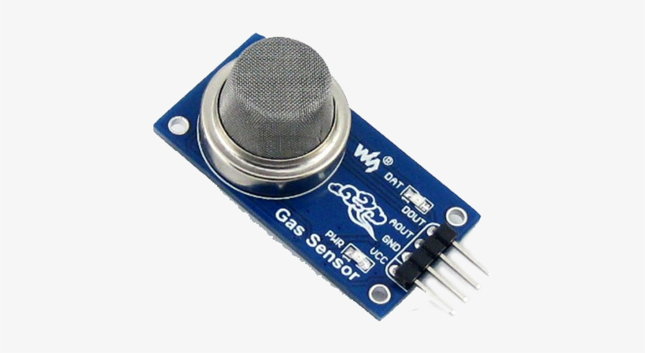
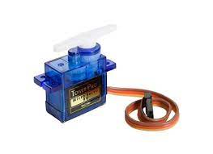
4. Gas Detector
A gas detector is a device that detects the presence of gases in an area, often as part of a safety system.
some gas detectors are MQ-2, Flammable Gas and Smoke Sensor,MQ-5, Methane LPG Gas Sensor.
5. Servo Motor
A servo motor is a type of motor that can rotate with great precision.
If you want to rotate an object at some specific angles or distance, then you use a servo motor.
It is just made up of a simple motor which runs through a servo mechanism.

Slide 23
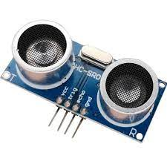
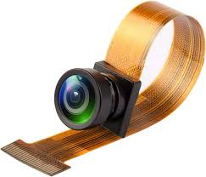
6.Ultrasonic Sensors
An ultrasonic sensor is an electronic device that measures the distance of a target object by emitting ultrasonic sound waves, and converts the reflected sound into an electrical signal. Ultrasonic waves travel faster than the speed of audible sound. Ultrasonic sensors have two main components: the transmitter and the receiver.
7.camera module
A modular camera has two detached parts: A smaller sensor unit consisting of the image sensor and lens, and a main unit where image processing and network communication takes place. The sensor unit connects via cable to the main unit, so the two parts can be placed separately from each other.

Slide 24
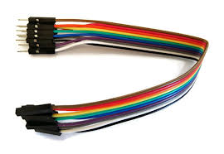
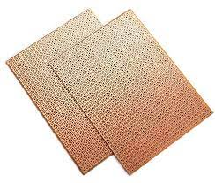
8. Jumper Wire
A jumper wire is an electric wire that connects remote electric circuits used for printed circuit boards. By attaching a jumper wire on the circuit, it can be short-circuited and short-cut (jump) to the electric circuit.
9.Pcb Board
A printed circuit board, or PCB, is used to mechanically support and electrically connect electronic components using conductive pathways, tracks or signal traces etched from copper sheets laminated onto a non-conductive substrate.

Slide 25
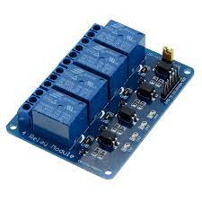
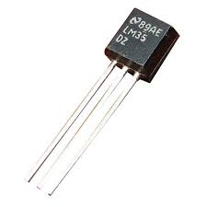
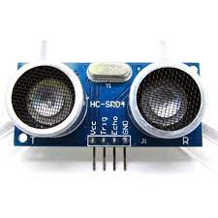
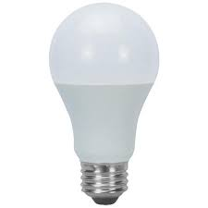
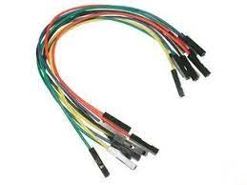
4 Channel Relay
LM 35
Ultrasonic Sensor
ESP 32 CAM
Camara Module
LED Light
Jumper wire
Servo Motor

Slide 26
ADVANTAGES
Managing all of your home devices from one place.
Flexibility for new devices and appliances.
Maximizing home security.
Remote control of home functions.
Increased energy efficiency.
Improved appliance functionality.

Slide 27
COST ANALYSIS
S. No. | Hardware Components | Specification | Quantity | Cost per unit
1. | ESP 32 Cam Module | CPU: Dual-core 32-bit LX6 microprocessor, operating at up to 240 MHz | 1 | ₹600
2. | Ultrasonic Sensor | Power Supply: 3.3V -5V. | 1 | ₹60
3. | Buzzer | Frequency range is 3,300Hz | 1 | ₹20
4. | Gas Detector | 4-20 milli-amperes, 0-10 volts DC or 0-3 volts DC | 1 | ₹150
5. | Power Supply (AC to DC ) | Input range: 90V-270V, 4863Hz | 1 | ₹150
6. | Servo Motor | 3,000 to 5,000 RPM | 1 | ₹150
7. | Heat Detector | 10.5 to 33 VDC from fire alarm control panel IDC | 1 | ₹35
8. | USB Cable | - | 1 | ₹150
9. | 4 Channel Relay | 5V | 1 | ₹400
10. | DC Motor Fan | High Torque Rated Voltage Current-DC 12VNo Load Current-0.2Amps | 1 | ₹120
11. | Jumper Wire | Current: 4-20 mA, Voltage: 12 V, Rated Pressure: 25 kPA, Pitch: 2.54 mm | 2 | ₹150
Total |  |  |  | ₹1,835/-

Slide 28
CONCLUSION
Main purpose of home automation system is to provide ease to people to control different home appliances with the help of the android application present in their mobile phones and to save electricity, time and money.

Slide 29
REFERENCES
Hill, Jim (12 September 2015). "The smart home: a glossary guide for the perplexed". T3. Retrieved 27 March 2017.
"Research and Markets: Global Home Automation and Control Market 2014-2020 - Lighting Control, Security & Access Control, HVAC Control Analysis of the $5.77 Billion Industry". Reuters. 2015-01-19. Archived from the original on 2016-05-05.
Home Automation & Wiring (1 ed.). New York: McGraw-Hill/TAB Electronics. 1999-03-31. ISBN 978-0-07-024674-4.
Rye, Dave (October 1999). "My Life at X10". AV and Automation Industry eMagazine. AV and Automation Industry eMagazine. Archived from the original on September 30, 2014. Retrieved October 8, 2014.

Slide 30
Thank You

